Slide 1
Demand-driven Execution of Directed Acyclic Graphs Using Task Parallelism
Prabhanjan Kambadur,
Open Systems Lab, Indiana University
With Anshul Gupta (IBM TJW), Torsten Hoefler (IU), and Andrew Lumsdaine (IU)

Slide 2
Overview
Motivation
Background
DAG execution
Case study
Conclusion

Slide 3
Motivation
Ubiquitous parallelism
Multi-core, many-core and GPGPUs
Support for efficient || execution of DAGs is a must
Powerful means of expressing application-level ||ism
Task parallelism does not offer complete support yet
Not studying DAG scheduling!

Slide 4
Dataflow models
Powerful parallelization model for applications
Id, Sisal, LUSTRE, BLAZE family of languages
Classified based on order of DAG nodes’ execution
Data-driven dataflow model
Computations initiated when all inputs become available
Demand-driven dataflow model
Computations initiated when inputs are needed

Slide 5
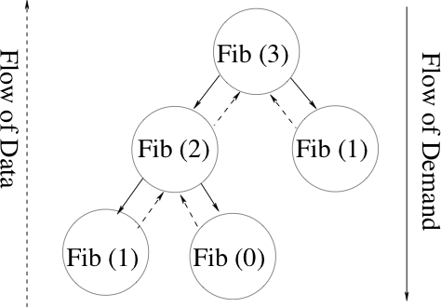
Fibonacci
int fib (int n) {
if (0==n || 1==n) return (n);
else return (fib (n-1) + fib (n-2));
}

Slide 6
Task parallelism and Cilk
Program broken down into smaller tasks
Independent tasks are executed in parallel
Generic model of parallelism
Subsumes data parallelism and SPMD parallelism
Cilk is the best-known implementation
Leiserson et al
C and C++, shared memory
Introduced the work-stealing scheduler
Guaranteed bounds on space and time
Because of fully-strict computation model

Slide 7
Parallel Fibonacci
cilk int fib (int n) {
if (0==n || 1==n) return (n);
else {
int x = spawn fib (n-1);
int y = spawn fib (n-2);
sync;
return (x+y);
}
1. Each task has exactly one parent.
2. All tasks returns to respective parents
Demand-driven execution!

Slide 8
Classic task parallel DAG execution
Flow of Data
Flow of Demand
Data-driven!

Slide 9
Demand-driven parallel DAG execution
Flow of Data
Flow of Demand
Does not follow the fully strict model
Multiple completion notifications

Slide 10
What is different?
In a large DAG
Spawning/completion order of nodes is different
Altered data locality
Lifetime of dynamic memory is affected
Altered memory profile
In a DAG with very few roots
Control over parallelization
Shut off parallelism at lower-levels

Slide 11
PFunc: An overview
Library-based solution for task parallelism
C and C++ APIs, shared memory
Extends existing task parallel feature set
Cilk, Threading Building Blocks (TBB), Fortran M, etc
Customizable task scheduling
cilkS, prioS, fifoS, and lifoS provided
Multiple task completion notifications on demand
Deviates from the strict computation model
Notes:
OpenMP, Tascell, Tpascal, MulTScheme left out on purpose.
Idea here is to identify the core features of task parallelism and lift it – like any good generic programmer!

Slide 12
Case Study

Slide 13
Sparse unsymmetric Cholesky factorization
U’
Flow of Data
Flow of Demand
L’
Update
Matrix
Frontal Matrix
Each node allocates memory
Memory is freed when all children are executed
Short and stubby DAGs with one root
Notes:
The DAGs were generated in the symbolic phase of the sparse unsymetric multifrontal cholesky solver. Two pieces of information are given to us – the structure and the weight. With the weight, we can calculate both the memory requirements and the computational structure (weight) of each node. The only difference is that in the real problem, the calculated LU is not always evenly distributed to the children. So the memory access patterns might be slightly different from the original. However, takes too much time to implement an actual solver.

Slide 14
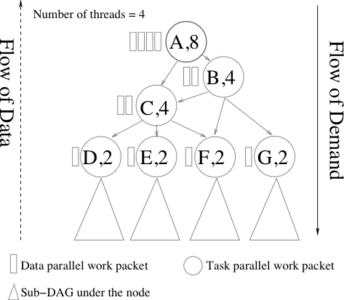
Demand-driven DAG execution

Slide 15
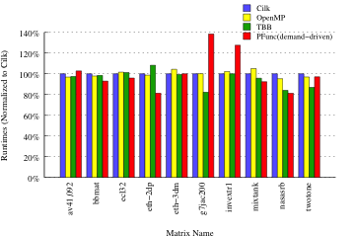
DAG execution: Runtime
Notes:
Hardware: Dual Intel X5365 quad-cores (8 cores).
Software: Cilk 5.4.6, SunCC 5.10, GCC 4.3.2, Linux 2.6.27, TBB 2.1.

Slide 16
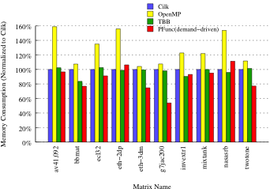
DAG execution: Peak memory usage
Notes:
Hardware: Dual Intel X5365 quad-cores (8 cores).
Software: Cilk 5.4.6, SunCC 5.10, GCC 4.3.2, Linux 2.6.27, TBB 2.1.

Slide 17
Conclusions
Need to support demand-driven DAG execution
Promotes user-driven optimizations
PFunc increases tasking support for
Demand-driven DAG execution
Multiple completion notifications
Customizable task scheduling policies
Future work
Parallelize more applications
Incorporate support for GPGPUs
https://projects.coin-or.org/PFunc

Slide 18

Questions?

